Slide 1

Vasvári József President

Slide 2
Ákos Gyömbér Chief Financial Officer

Slide 3

Our mission statement:
The Central European Club Pannonia is a civil society organization whose basic goal is to foster Central European relations in accordance with the standards of the European Union. To this end, it carries out its activities primarily in the fields of economic life, science, environmental protection, culture, historical traditions, tourism, nationality affairs, information exchange and informing the public.
Keeping in mind the implementation of its corporate tasks, it organizes events (conferences, round table discussions, professional consultations, study tours), thus helping to provide its members and those interested outside of it with extensive information and information. It also considers it its duty to exchange experience in the field of public safety and the fight against terrorism, as well as to provide professional and moral support to all its members who are in need of this.
It is gradually expanding its activities to all countries of Central Europe.

Slide 4

Introduction of KEP
The Central European Club Pannonia Public Benefit Association is a non-partisan NGO whose main goal is to expand Central European relations towards China
economic life,
the science,
environmental protection,
the culture,
historical traditions,
tourism,
nationality matters,
the exchange of information and
in the field of informing the public.…

Slide 5
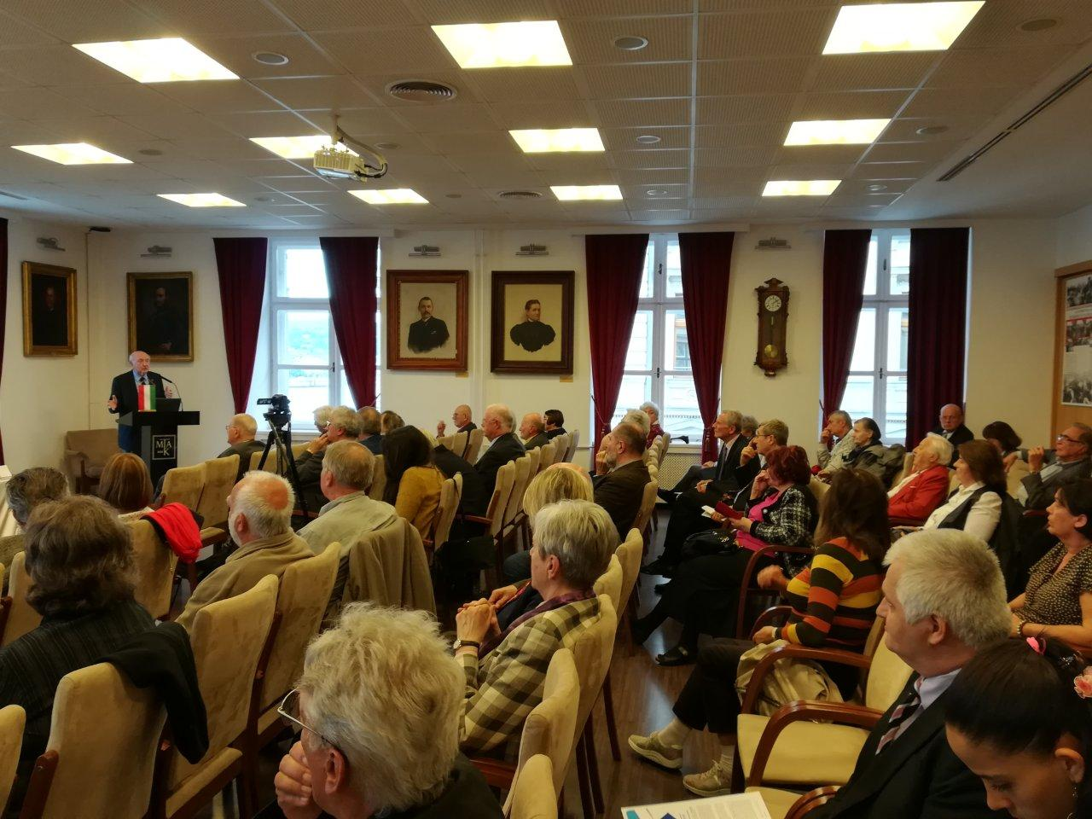
The topics of our Social Dialogue Forum series were:
Social responsibility of actors in public life and the economic sphere
Tasks to create "the service state“
The socio-economic effects of the global economic crisis

Slide 6


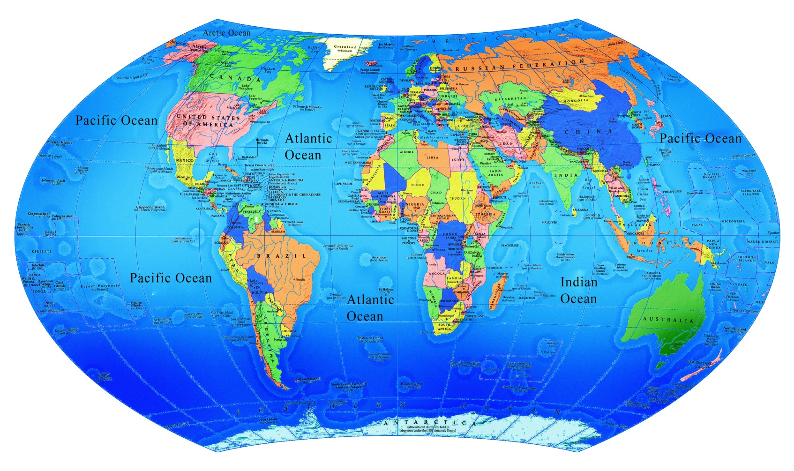
Let's connect

Slide 7

Our services for You
consultancy / civil relation network
company representation
partnership for D+R cooperation
AI supported communication – any language
investment opportunities in Hungary and EU
key to Europe
opportunities
partnership for vertical farm innovation

Slide 8
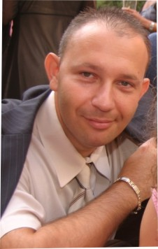

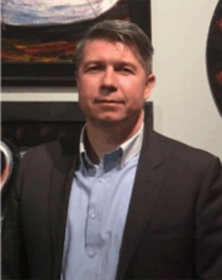

Thank you for your attention!
Vasvári József
President
Gyömbér Ákos
Chief Financial Officer
Supported by the Hungarian Innovation Agency

